Slide 1
Name That Artist!

Slide 3
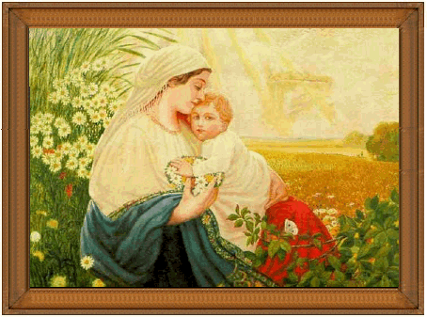
La mére et son fils

Slide 4
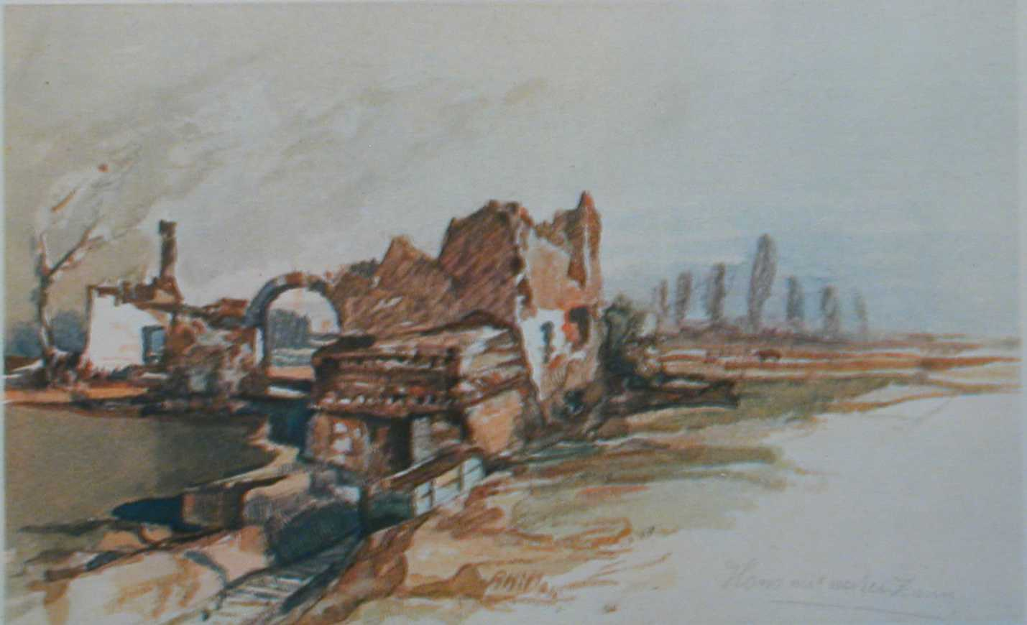
C’est la maison avec la clôture blanche

Slide 5
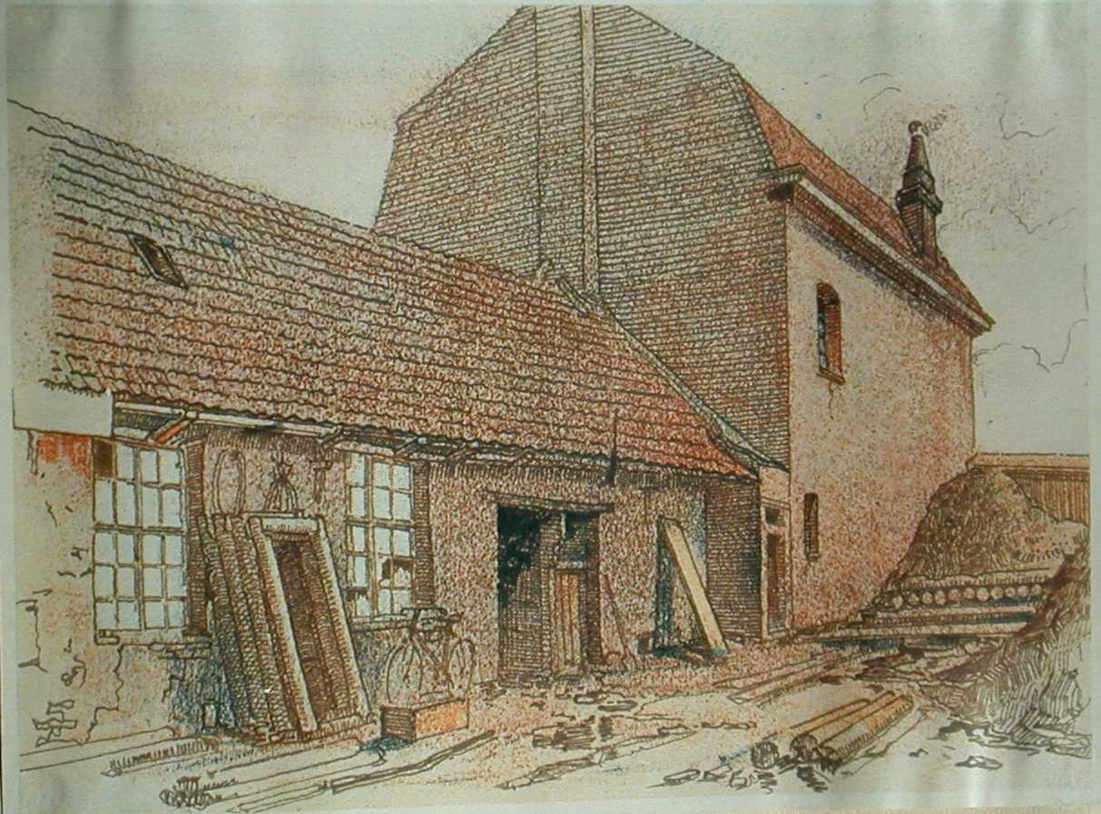
Shelter in Fournes

Slide 6
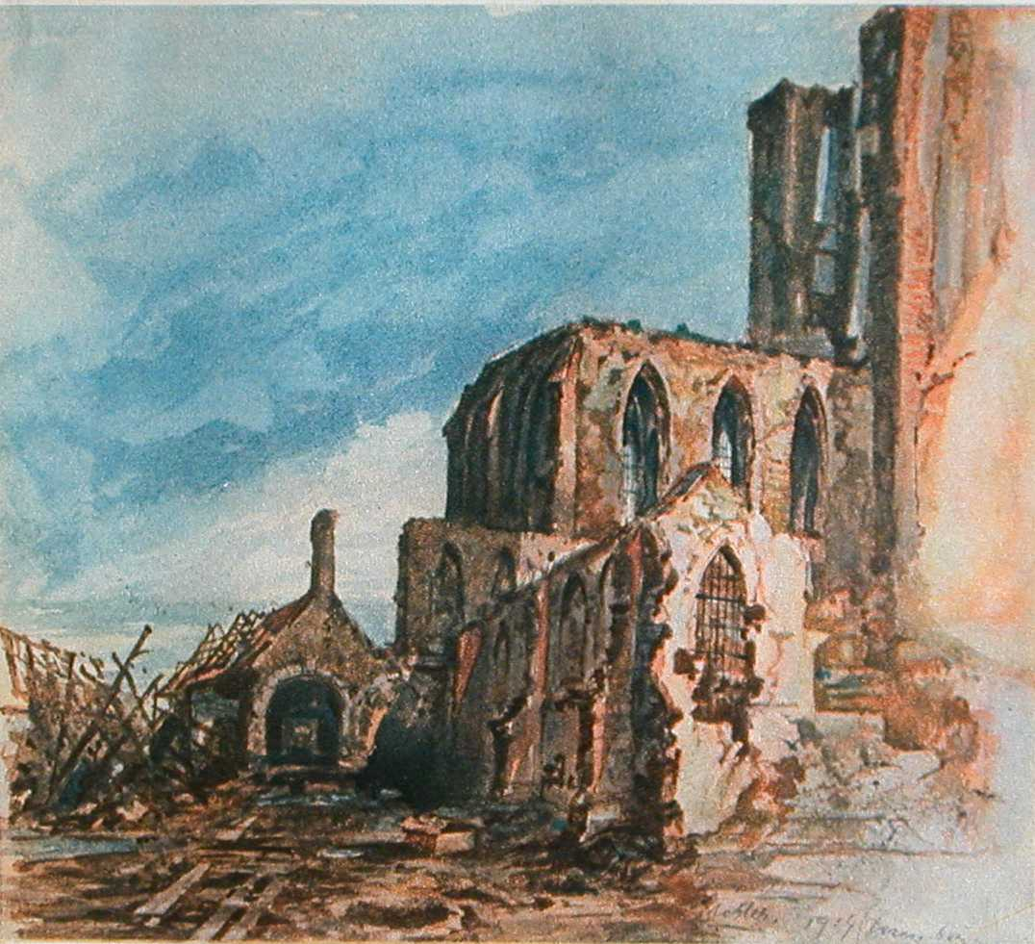
Ruins of a Cloister in Messines

Slide 7
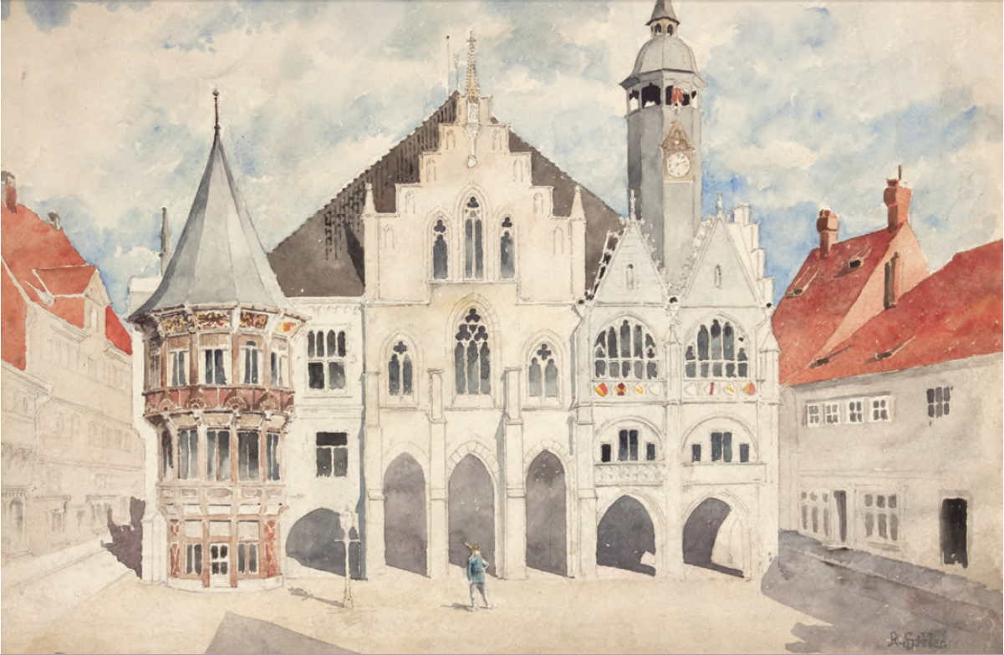
Untitled

Slide 8
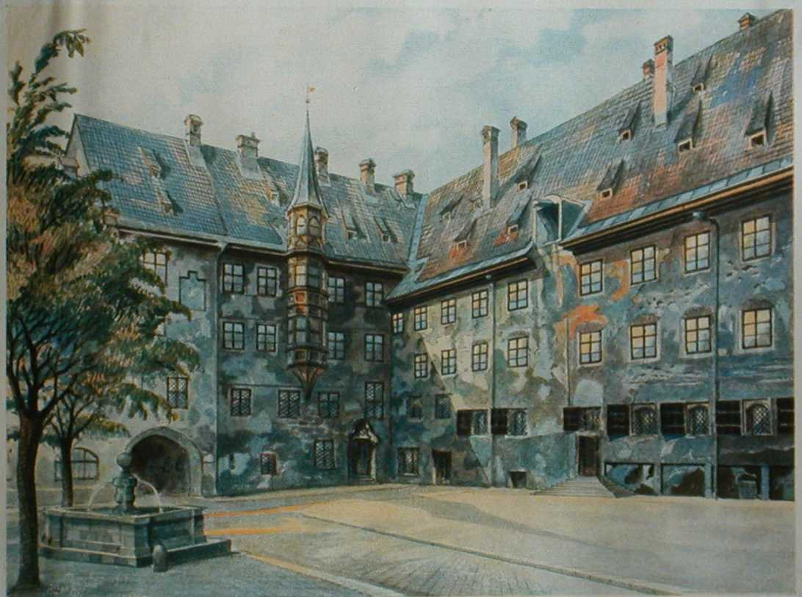
The Courtyard of the Old Residency

Slide 9
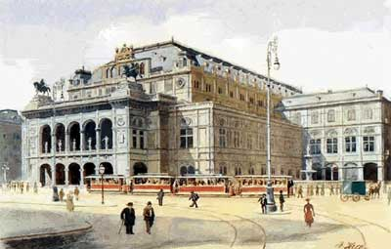
Venetian Opera House

Slide 10
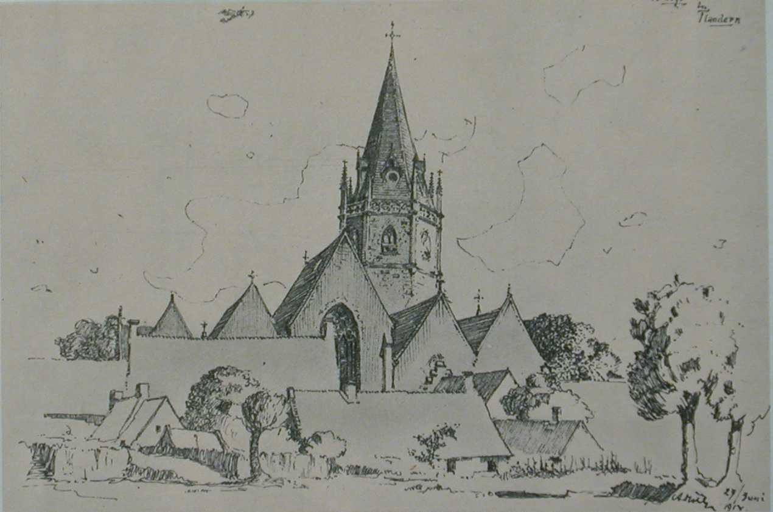
Ardoye in Flanders

Slide 11
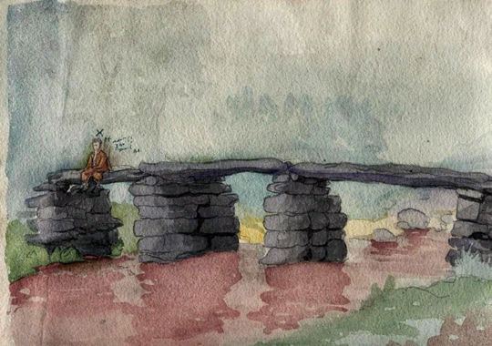
Thought-flow

Slide 12
Name That Artist!

Slide 13
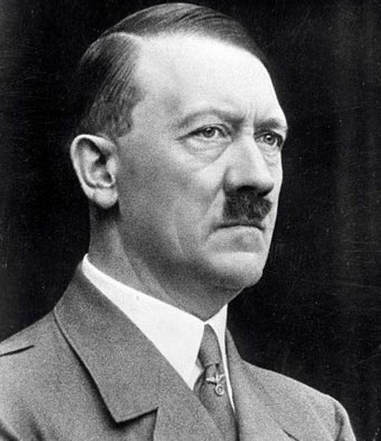

Slide 14
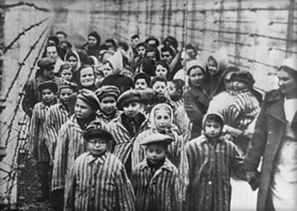
How do you go from…
This to this?

Slide 15
Monsters
Monsters exist, but they are too few in number to be truly dangerous. More dangerous are the common men, the functionaries ready to believe and to act without asking questions.
- Primo Levi, Jewish-Italian chemist and Holocaust survivor

Slide 16
-- What is your view of the world? (postmodern or modern) -- Is there such a thing as absolute good? -- Is there such a thing as absolute evil? -- Who should decide what is good and what is bad?
Get into pairs and discuss the following…

Slide 17
Milgram Obedience Study- 1961

Slide 18
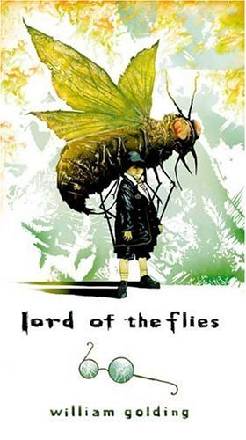
Lord of the Flies
William Golding
1911- 1993

Slide 19
Post-modernism
Postmodernism is a paradigm through which one can interpret events and actions, as well as works of art, music, and literature. It’s like a set of night- vision goggles that lets you see things that others cannot see. It’s a way of looking at the world.

Slide 20
Post-modernism

Slide 21
Post-modernism
Postmodernists believe that there is no absolute truth. What is true for one person may not be true for another, and what we, as a society, have held to be true for a long time, could turn out to have been a figment of our imagination the entire time.
Postmodernist thought is very egocentric. Sight is turned inside the self for truth, rather than to an objective outside.
i.e. “Truth is relative.” / “My truth might be different than your truth.”

Slide 22
Post-modernism
The key words to describe post-modernism are…
-- Subjectivity (opposite: )
-- Individual (opposite: )
-- Disillusioned (opposite: )
With postmodernism, the impossible becomes possible but not in a good way.

Slide 23
Post-modernism
The key words to describe post-modernism are…
-- Subjectivity (opposite: Objectivity )
-- Individual (opposite: )
-- Disillusioned (opposite: )
With postmodernism, the impossible becomes possible but not in a good way.

Slide 24
Post-modernism
The key words to describe post-modernism are…
-- Subjectivity (opposite: Objectivity )
-- Individual (opposite: social morés )
-- Disillusioned (opposite: )
With postmodernism, the impossible becomes possible but not in a good way.

Slide 25
Post-modernism
The key words to describe post-modernism are…
-- Subjectivity (opposite: Objectivity )
-- Individual (opposite: social morés )
-- Disillusioned (opposite: enchanted )
With postmodernism, the impossible becomes possible but not in a good way.

Slide 26
Post-modernism
This movement came about during and after World War II.
Why do you think that people would have been disillusioned with the world following the War? Why did the post-modern view take on such a raw vitality?

Slide 27
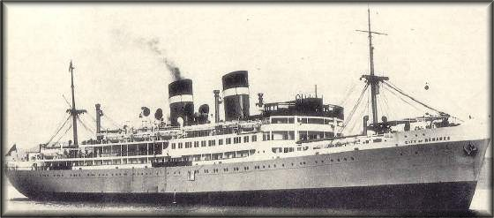
The World Golding Knew
WWII 1939 - 1945
The fall of France to Nazi Germany in1940
Britain feared an invasion and evacuated children to other countries
9/18/1940- A German U-Boat torpedoed a British ship carrying children to be evacuated to Canada. 77 of the 90 children were killed.
City of Benares

Slide 28
Major WWII Events
1939- Britain joined France in war against Nazi Germany
1940- Fall of France
1940- Fascist Italy joins the Axis with Germany
1941- Japan attacks Pearl Harbor causing USA to declare war on Japan and enter the world war
1944- D-Day Normandy Landings
1945- Bombing of Dresden
1945- European victory celebrated
1945- Atomic Bomb dropped in Hiroshima immediately killing 60-80,000 people (final death toll 135,000 people)
Death and destruction abound!!!

Slide 29
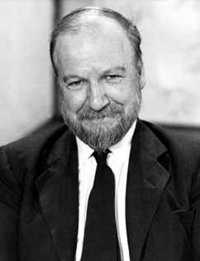
About William Golding
Born September 19, 1911. Died June 19, 1993
British novelist w/scientific background
Winner of the Nobel Prize in literature (‘83)
Knighted in 1988
Fought in Royal Navy during WWII
Participated in invasion of Normandy on D-Day (and headed unsuccessful naval assault for which he blamed himself)
At war’s end he returned to teaching and writing

Slide 30
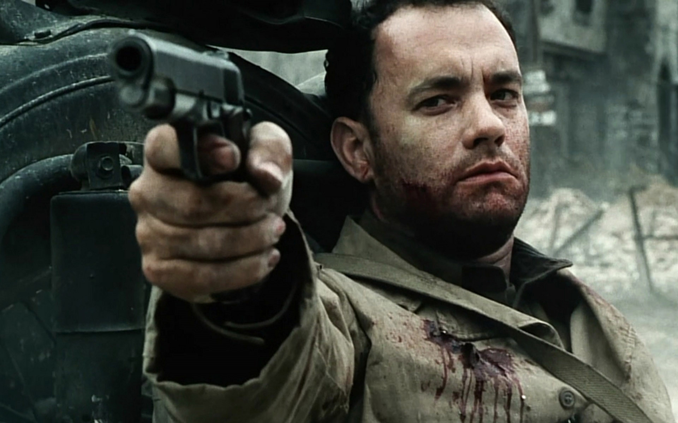
Think about it…

Slide 31
Golding’s Fiction
Allegory (meaning: )
Allusions to
Classical literature ( )
Mythology ( )
Christian Symbolism ( )
In this way Golding can be considered a postmodern C.S. Lewis.
How?

Slide 32
Golding’s Fiction
Allegory (meaning: one-to-one )
Allusions to
Classical literature ( )
Mythology ( )
Christian Symbolism ( )
In this way Golding can be considered a postmodern C.S. Lewis.
How?

Slide 33
Golding’s Fiction
Allegory (meaning: one-to-one )
Allusions to
Classical literature ( paganism )
Mythology ( )
Christian Symbolism ( )
In this way Golding can be considered a postmodern C.S. Lewis.
How?

Slide 34
Golding’s Fiction
Allegory (meaning: one-to-one )
Allusions to
Classical literature ( paganism )
Mythology ( Snake demons )
Christian Symbolism ( )
In this way, Golding can be considered a postmodern C.S. Lewis.
How?

Slide 35
Golding’s Fiction
Allegory (meaning: one-to-one )
Allusions to
Classical literature ( paganism )
Mythology ( Snake demons )
Christian Symbolism ( The Garden of Eden and Be’elzebub)
In this way, Golding can be considered a postmodern C.S. Lewis.
How?

Slide 36
Modern Day Allusions
Allusion- (n.) an indirect reference to something
There are many, many modern day allusions to Lord of the Flies in popular culture.
For example….

Slide 37
The Simpsons
The Simpson’s episode titled Das Bus is a parody of Lord of the Flies.

Slide 38
Survivor
Mark Burnett’s CBS island show is said to have been inspired by LOTF.

Slide 39
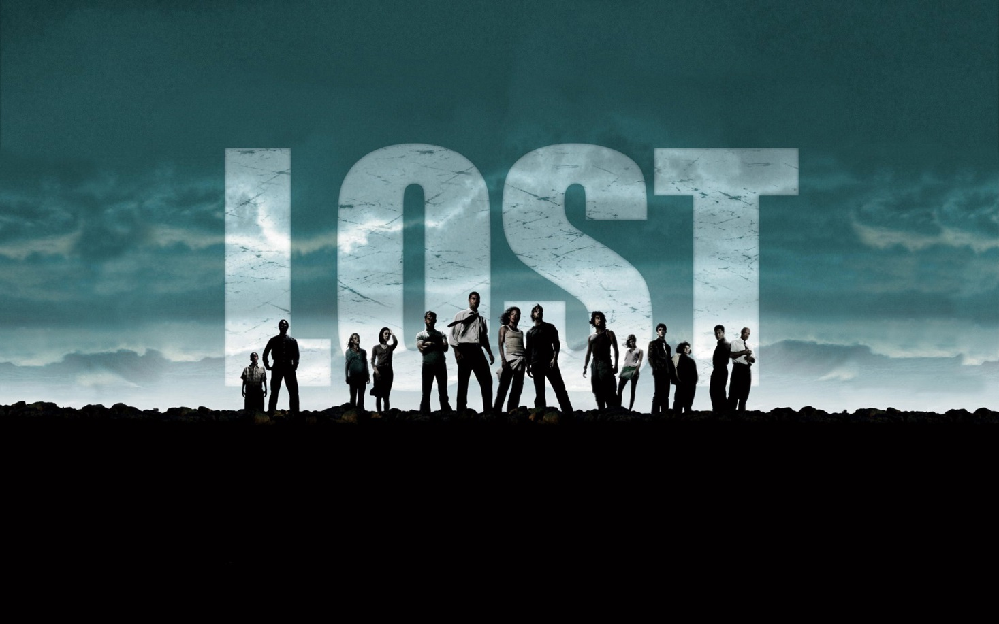
Lost
“Survivors” of a plane crash are marooned on an uninhabited island.

Slide 40
Sponge Bob Squarepants
The episode Club Spongebob is a spoof of LOTF.

Slide 41
The Hunger Games

Slide 42
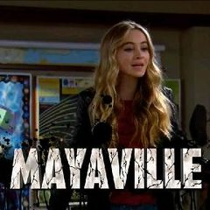
Girl Meets World

Slide 43
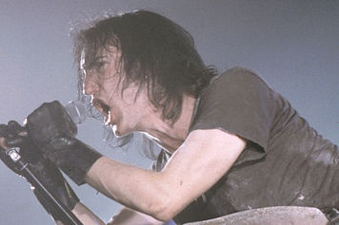
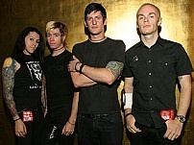
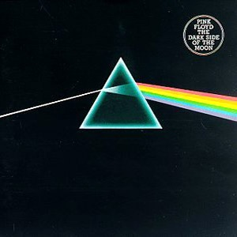
Popular Music
Bands such as Taking Back Sunday, Nine Inch Nails, AFI, Iron Maiden, and Pink Floyd have written songs about or have alluded to LOTF in their music.

Slide 44
Popular Culture
“It was, so far as I can remember, the first book with hands—strong ones that reached out of the pages and seized me by the throat. It said to me, ‘This is not just entertainment; it’s life-or-death.’

Slide 45
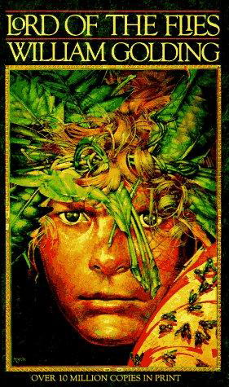
Lord of the Flies
“It was simply what seemed sensible for me to write after the war when everyone was thanking God they weren’t Nazis. I’d seen enough to realize that every single one of us could be Nazis.”
William Golding on his novel Lord of the Flies

Slide 46
William Golding

Slide 47
He says that this is a book about “evil,” but, of course, you’re not evil, so why are we reading it? Or are you?

Slide 48
Eye Color Experiment- 1968

Slide 49
Bandura Bobo Doll Experiment

Slide 50
Stanford Prison Experiment- 1971

Slide 51
Stanford Prison Experiment- Movie

Slide 52
About the Novel
Was first published in 1954.
Was not a success when it was first published.
It sold less than 3,000 copies in the U.S. before going out of print in 1955.
Went on to become a best-seller in the UK and beyond, becoming required reading in many schools.

Slide 53
About the Novel
Set in mid 1940s when Europe is engulfed in war. (***Note*** does the novel ever mention what war is going on? Why?)
A plane carrying British school boys is mistaken for a military craft and shot down.
Only the boys survive the crash, and they try to form a society to govern themselves.

Slide 54
Themes in the Novel
A theme is…
A theme is NOT….
The difference between subjects and themes…

Slide 55
Themes in the Novel
Civilization and savagery are opposites. One has nothing to do with the other.
Everyone loses their innocence.
We are all cursed with original sin.
Fear separates one from humanity.
Our idea of good and evil is skewed.
Goodness is rare and fleeting.

Slide 56
Motifs in the Novel
(First, a motif is…)
Biblical parallels (book sometimes criticized for plagiarizing episodes in the Bible)
Pristine places corrupted by evil (This sounds like…) VERY IMPORTANT: Loss of innocence (THE Fall)

Slide 57
Symbols in the Novel
The Conch- Civilization and order
The Beast- The fear that separates man from God
Piggy’s Glasses- Reason, science and insight
Be’elzebub- True evil (Where does it come from?)
Fire Signal- Hope, salvation

Slide 58
Philosophical Influence
John Hobbes
English Philosopher: 1588- 1679
Man is by nature selfishly individualistic
Man constantly at war with other men
Fear of violent death is sole motivation to create civilizations
Men need to be controlled by absolute sovereignty to avoid brutish behavior (CANNOT rule themselves)

